Slide 1


Impact of Solder Voids on Power Module Thermal Resistance Using Transient System Analysis
Nathan Carlson
Dept. of Electrical and Computer Engineering
The University of Alabama
ncarlson@crimson.ua.edu
Dr. Nicholas Baker
Dept. of Electrical and Computer Engineering
The University of Alabama
nbaker2@crimson.ua.edu

Slide 2
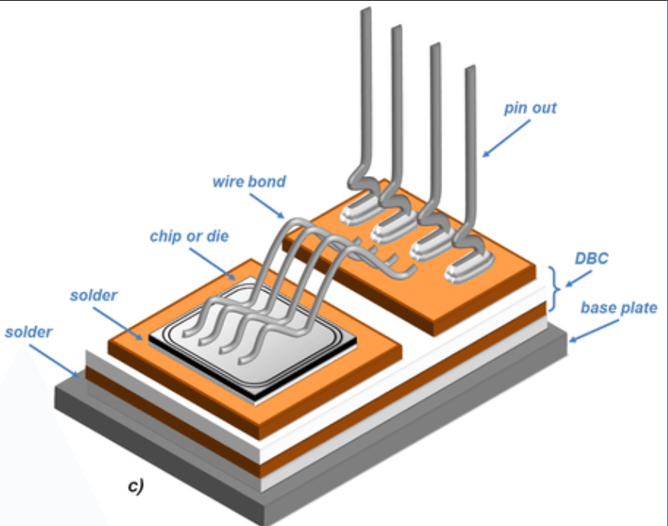



Why do we care about Thermal Resistance?
High thermal resistance = large temperature difference needed to conduct losses
$R_{th}$ = $\frac{∆T}{P}$
Excess heat leads to semiconductor or package failure
Fig 1. General Layout of Power Module. [1]
Lowering Rth allows for…
Cheaper / smaller cooling equipment
OR
OR
Higher reliability and lifetime
Higher power output

Slide 3
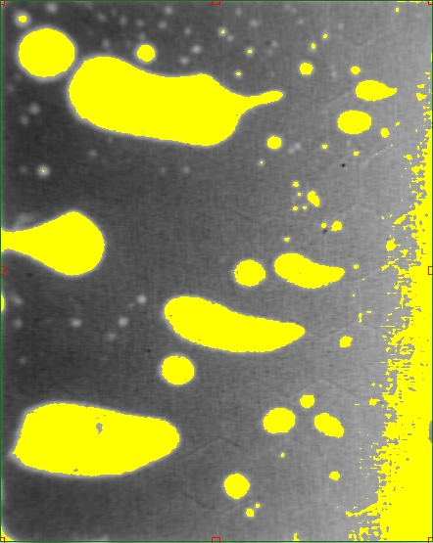
Void Percentage Calculation
Fill Tool Method
Capture Xray image of solder
Import into Photoshop
Use the fill tool to select voided areas*
Calculate the number of red pixels vs total pixels
Fig 4. Void selection with Threshold method.
Traditional threshold method susceptible to chip tilt errors
*Fill Tool Threshold settings: 35, 27, 20, 13, 5. Use high settings for large voids and voids with highly contrasted edges.
Fig 3. Selection of voided areas using Fill Tool method.

Slide 4
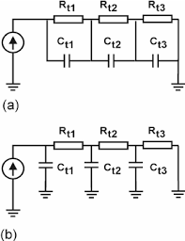
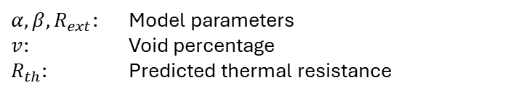
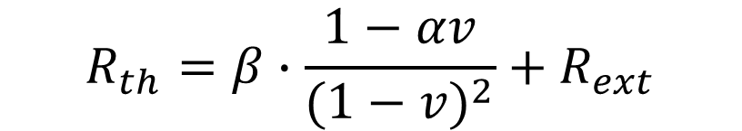
The Experiment
Hypothesis
Voids cause an increase in the thermal resistance of a power module.
Should be predicted by the equation:
Should be able to be modeled as an LTI system:
$$R_{th}=β∙\frac{1−αv}{{(1−v)}^{2}}+R_{ext}$$
$α, β,R_{ext}$: Model parameters
$v$: Void percentage
$R_{th}$: Predicted thermal resistance
Fig 5. Foster network (a) and Cauer network (b) can be used as representations of LTI thermal systems [2].

Slide 5
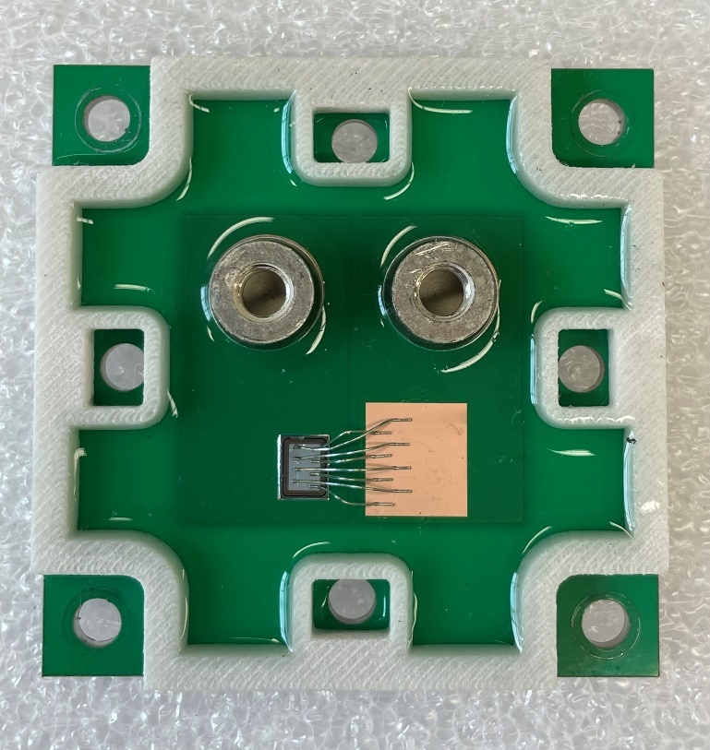
Sample Creation
10 Samples
Diode Information:
SAC 305 solder paste
‘X’ shaped stencil with 100um thickness
Reflow in convection oven: Manncorp MC 301
Two reflow profiles used (see appendix)
PCB surface metallization: bare Cu
Model: VS-4FD198H06A6BC
Size: 5.03mm X 3.35mm
Rated current: 50A
Fig 6. Test sample construction.

Slide 6

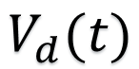

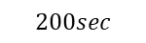
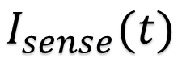


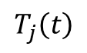
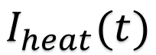

Rth Test Setup
Diode Junction Temperature Calculation
$$V_{d}(t)$$
+ -
$$T_{j}\left(t\right)=−227{V_{d}\left(t\right)}^{2}−241V_{d}\left(t\right)+247$$
Example Cooling Curve
$$T_{j}\left(t\right)$$
$$I_{heat}(t)$$
$0$ $200sec$
$$I_{sense}(t)$$
$$50 mA$$
Tested currents: 5, 10, 15, 20, 22, 24A
$0$ $200sec$
$$t$$
$$200sec$$

Slide 7
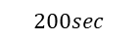



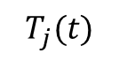
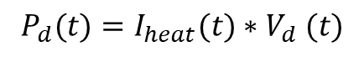
Postprocessing: Extraction of Heating Curve
Goal: Given a cooling curve, calculate the heating curve
Assumption 1
Thermal system is linear and time-invariant (LTI)
Assumption 2
System reaches steady-state within 200 seconds
$$P_{d}(t)=I_{heat}(t){∗V}_{d}(t)$$
Cooling
Thermal System
$$T_{j}(t)$$
$200sec$
$${\hat{P}}_{d}\left(t\right)=P_{i}−P_{d}\left(t+200\right)$$
Heating
Thermal System
$${\hat{T}}_{j}\left(t\right)=T_{j}\left(200\right)−T_{j}\left(t+200\right)+T_{env}$$
$0$

Slide 8
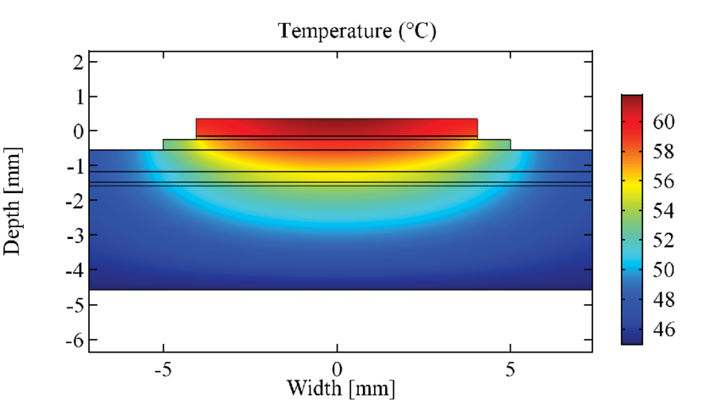




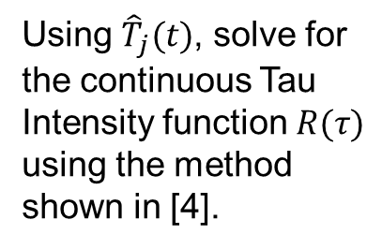




Postprocessing: Tau Intensity Calculation
Single Element
Step response
Equivalent circuit
$T\left(t\right)=R∗(1−e^{−\frac{t}{τ}} )$
$$τ=RC$$
Fig 7. Example diagram of heat flow through a power device [3].
Lumped Element
Increasing Accuracy
Step response
Equivalent circuit
$$T\left(t\right)=\sum_{n=1}^{N}{R_{n}∗(1−e^{−\frac{t}{τ_{n}}} )}$$
$$1$$
$$2$$
$$N$$
Using ${\hat{T}}_{j}(t)$, solve for the continuous Tau Intensity function $R(τ)$ using the method shown in [4].
Continuous
Step response
Equivalent circuit
$$T\left(t\right)=\int_{0}^{∞}{R\left(τ\right)∗\left(1−e^{−\frac{t}{τ}}\right)dτ}$$
$$N=∞$$

Slide 9
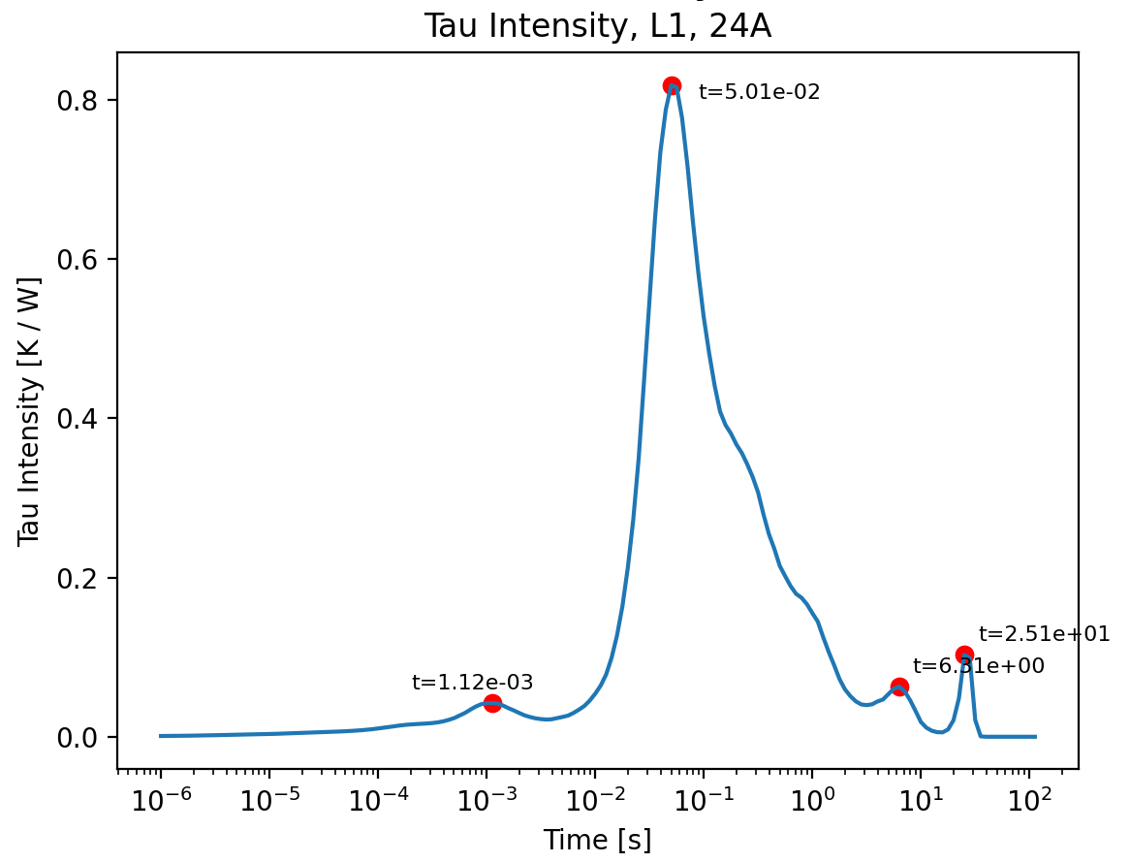
Postprocessing: Tau Peak Identification
Purpose of Tau Intensity
Peaks of the tau intensity plot correspond to high R and low C relative to the surrounding region
The first tau peak (1.12 ms) corresponds to the first material junction from the chip to the solder layer
Thus, measuring Zth at ~1.12 ms should give more accurate measurements than in steady-state
Fig 8. Plot of Tau Intensity vs time, with peaks identified.

Slide 10
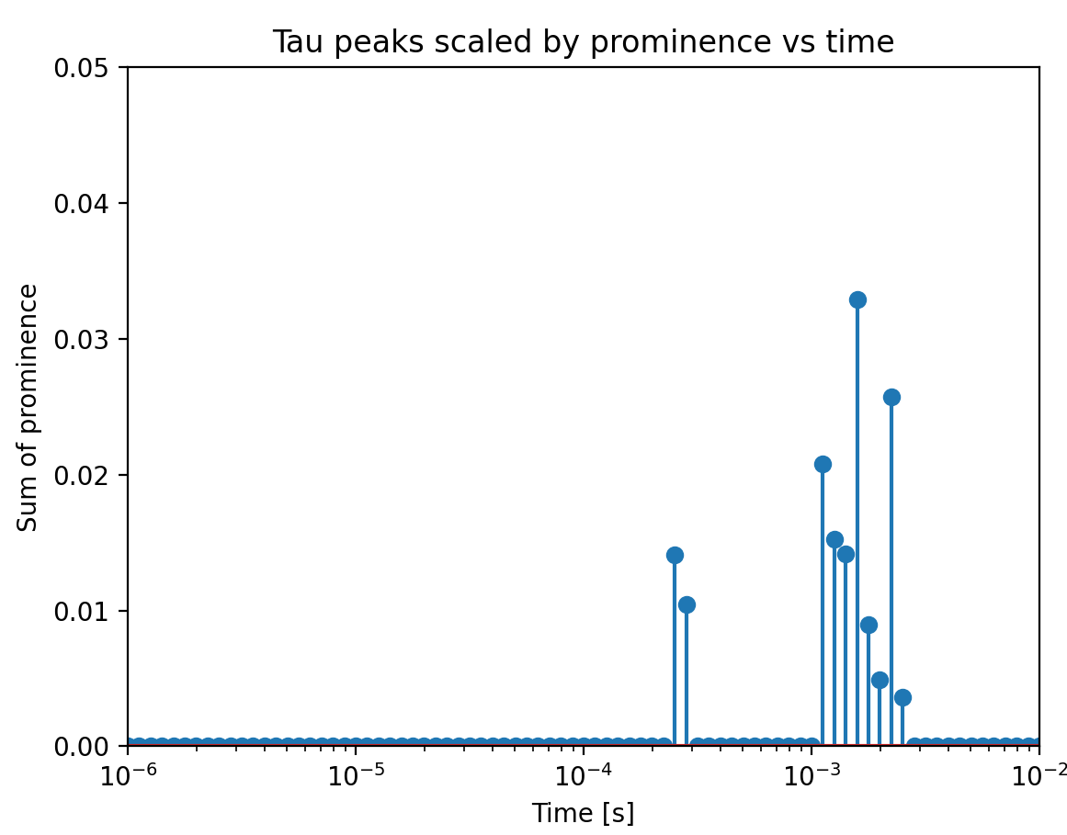
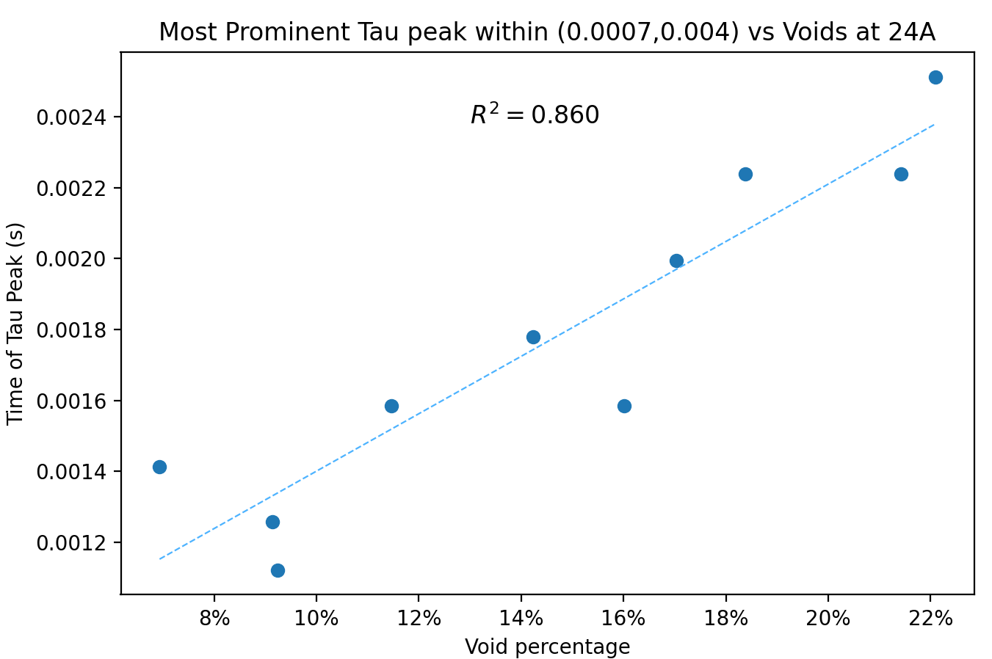
Results: First Tau Peak Distribution
Where does the first peak occur most often?
Does the time of the first peak have a correlation with the void percentage?
Fig 9. Histogram of all first tau peak times, scaled by how prominent the peak is.
Fig 10. Linear correlation of the time of the tau peak to the void percentage

Slide 11
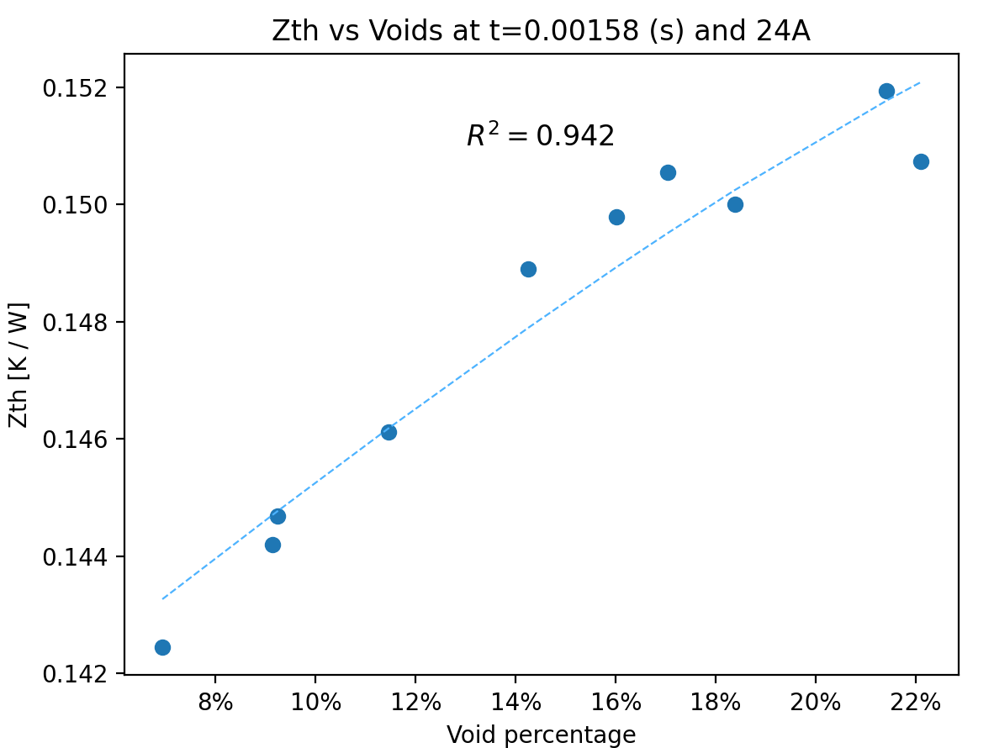
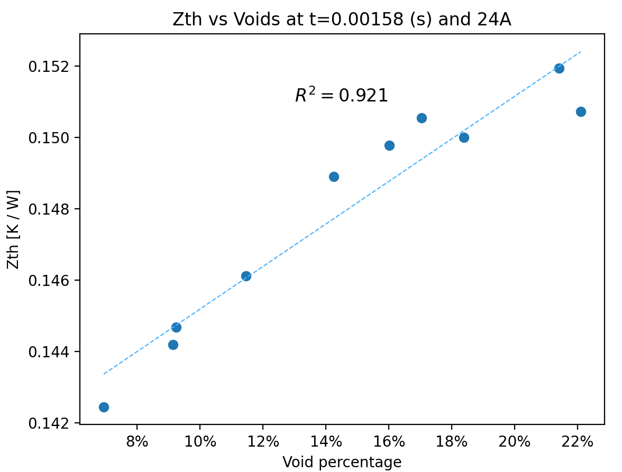

Results: Zth(t) for t = 1.5 ms
Model fit ($α=1.51, β=0.138, R_{o}=0$)
Linear fit
Fig 11. Zth vs Voids at 1.58 ms with model fit
Fig 12. Zth vs Voids at 1.58 ms with linear fit

Slide 12
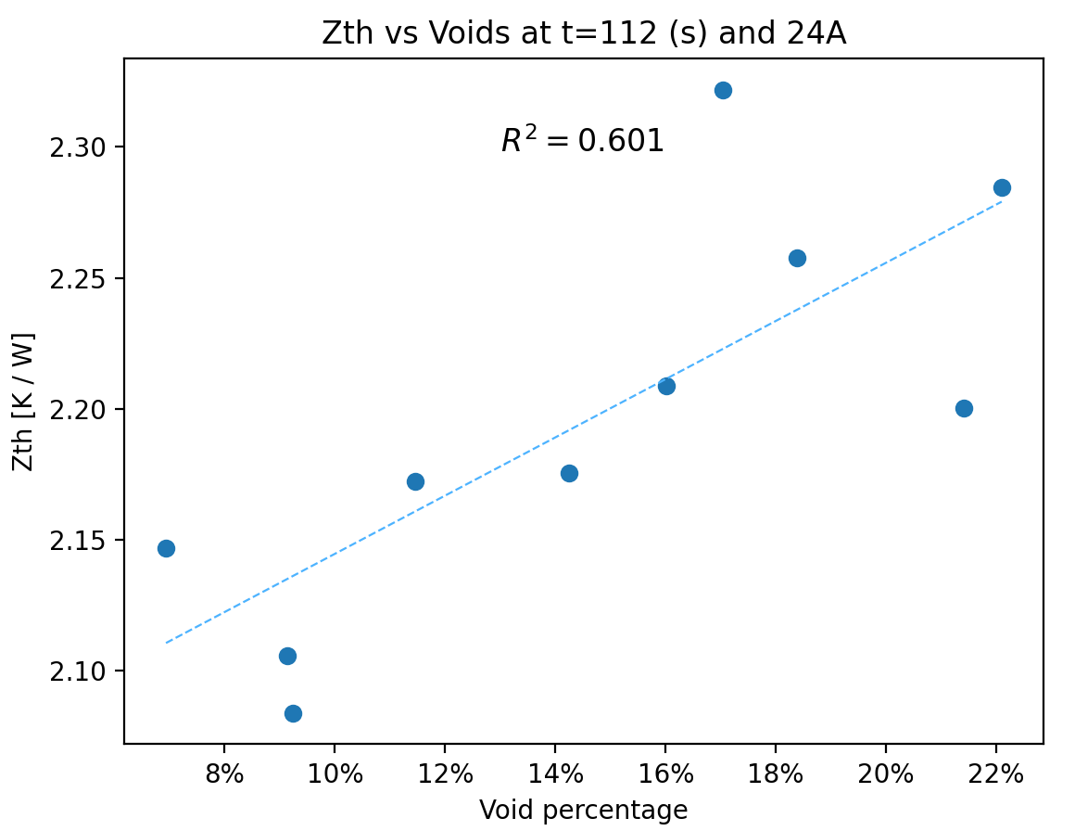
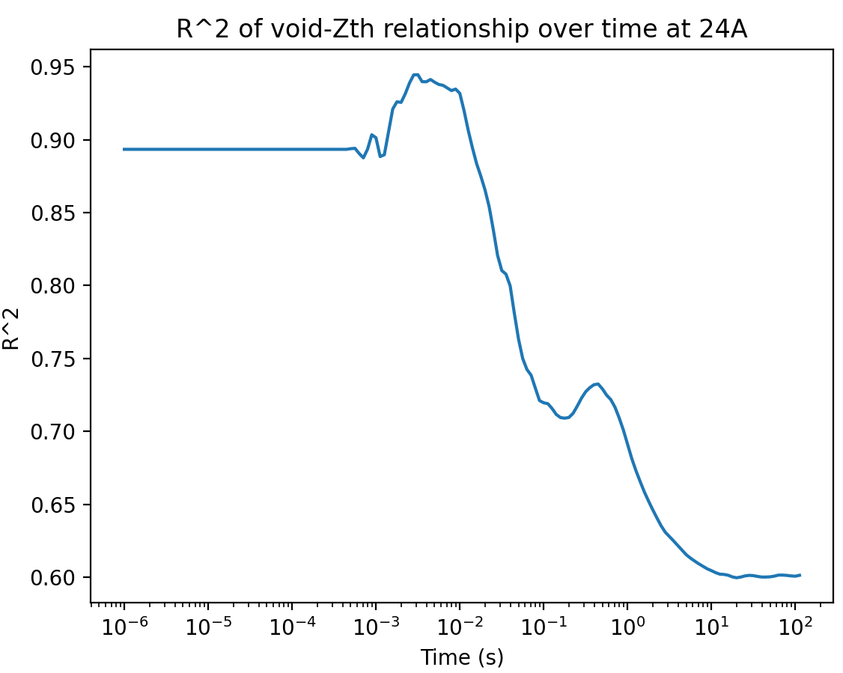
Results: Zth(t) Correlation at Non-Peak Times
What does Zth look like near steady-state?
Much weaker correlation due to variable thermal resistance of layers between the solder and heat sink
At what time does the void percentage have the highest correlation with Zth?
Peaks at ~3 ms, close to the predicted time constant associated with the chip-to-solder interface!

Slide 13
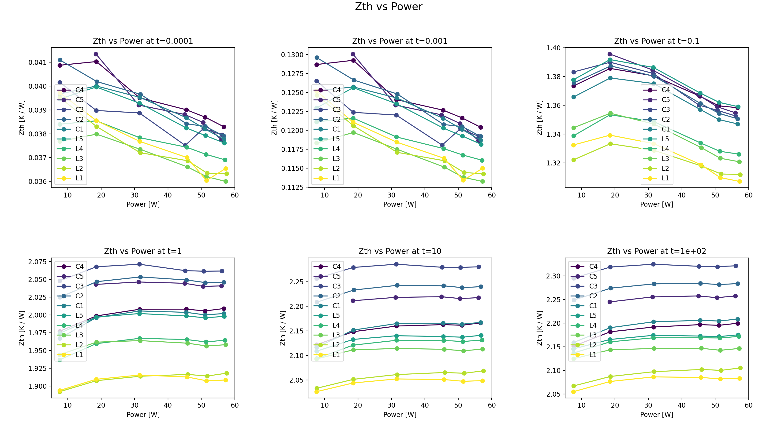
Results: Is the Thermal System Truly Linear?
Fig 14. System linearity check by measuring Zth at several values of applied power, as well as at various times.

Slide 14
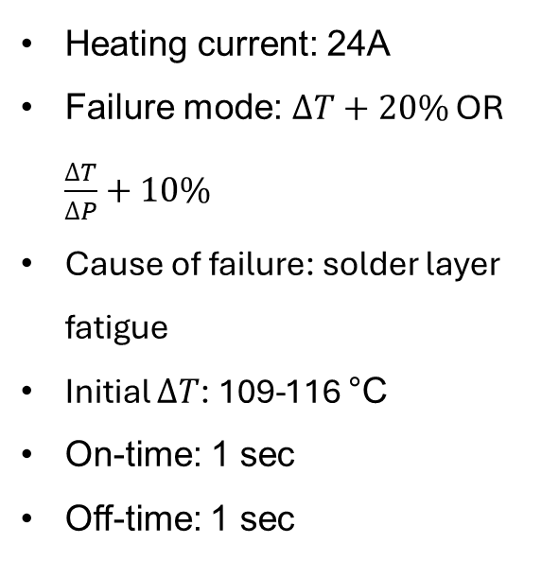
Results: Power Cycling
Cycling Conditions:
Heating current: 24A
Failure mode: $∆T+20\%$ OR $\frac{∆T}{∆P}+10\%$
Cause of failure: solder layer fatigue
Initial $∆T$: 109-116 °C
On-time: 1 sec
Off-time: 1 sec
Fig 15. Power cycling results, showing a negative correlation with void percentage.

Slide 15
Important Results and Discussion
Voids have a distinct effect on thermal resistance, but the absolute change in Rth of the whole package is relatively small.
Voids cause a significant decrease in the lifetime of the solder layer during power cycling.
While our model is able to capture the data trends, it is unclear whether it is truly a good indicator of thermal resistance.
The methodology used for postprocessing appears to be able to accurately measure the thermal resistance of the solder with minimal influence from other layers.

Slide 16
Future Work
Processing / Computational
Experimental
Finite Element Simulation as a third point of verification for the time constant associated with the chip-to-solder interface
Accurate implementation of structure function method and comparison to the method presented here
Generalization of postprocessing to include arbitrary / pulsed heating current waveforms
Create a general tool / metric to analyze the effect of void size and position
More samples! See if the model is truly accurate, and also examine results for different solder alloys, surface metallizations, and chip types.
Test increased PCB thickness to determine if this causes the first tau peak to increase in prominence

Slide 17
Acknowledgements
References
[1] Cosiansi, Fernando. (2016). ISPET: Interface Sintering Process Enhanced Technology. 10.6092/polito/porto/2643767.
[2] Zhou, Zhongfu & Holland, Paul & Igic, Petar. (2008). Compact thermal model of a three-phase IGBT inverter power module. 167-170. 10.1109/ICMEL.2008.4559249.
[3] Bjørn Jørgensen, Asger & Christensen, Nicklas & Dalal, Dipen & Sønderskov, Simon & Bęczkowski, Szymon & Uhrenfeldt, Christian & Munk-Nielsen, Stig. (2017). Reduction of parasitic capacitance in 10 kV SiC MOSFET power modules using 3D FEM. 10.23919/EPE17ECCEEurope.2017.8098962.
[4] Vladimir Székely, Tran Van Bien, Fine structure of heat flow path in semiconductor devices: A measurement and identification method, Solid-State Electronics, Volume 31, Issue 9,1988, Pages 1363-1368, ISSN 0038-1101, https://doi.org/10.1016/0038-1101(88)90099-8. (https://www.sciencedirect.com/science/article/pii/0038110188900998)
Dr. Nicholas Baker
Questions?

